Slide 1
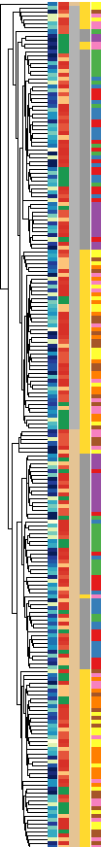
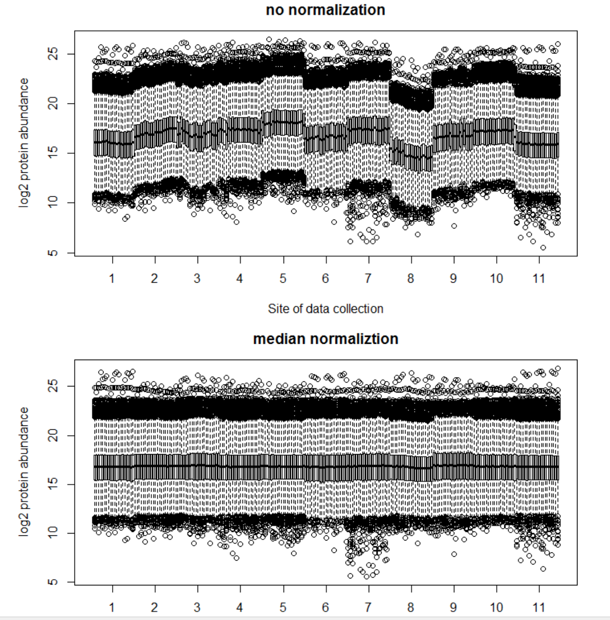
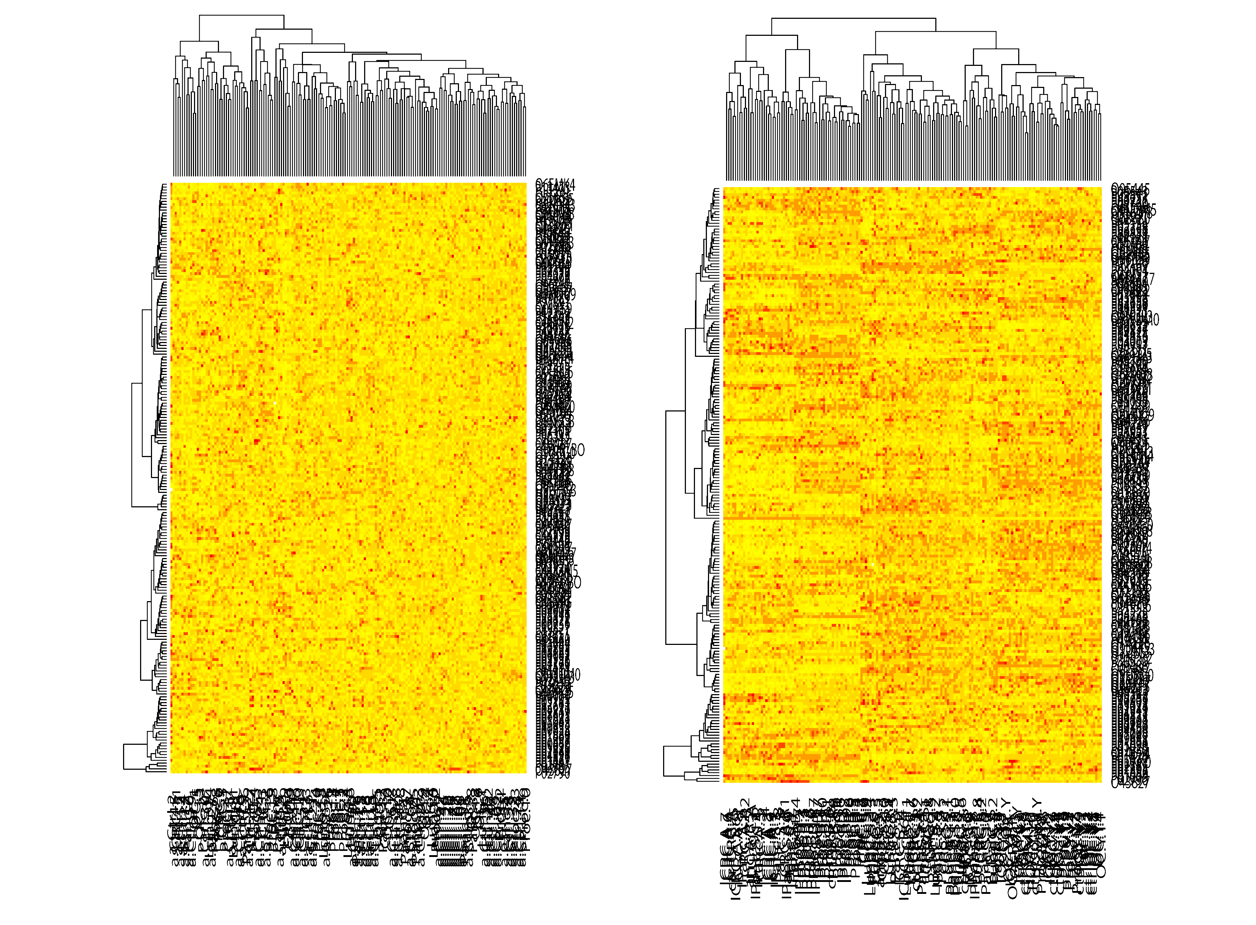
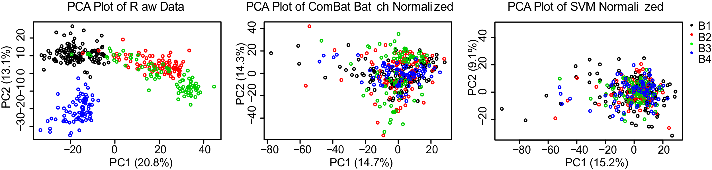
Batch effects
Hierarchical clustering
Boxplot
PVCA plot

Slide 2
Pre-processing
Remove requants
rough first idea
Average Intensity
heatmap (for this, it’s a good idea to substitute requants (now NAs with numeric value different from the initial)
dig deeper
hierarchical clustering labelled with all covariates
PCA – color by biological and technical covariates
log-transform
long-to-wide
boxplots
iRTs
quantify the effects with PVCA
Bovine (Spike-ins)
Correct
quantile normalization
non-linear + ComBat / ComBat
Run diagnostics again
When using ComBat, make sure you remove the peptides missing in the whole batch
iRT
some random protein/peptide
clustering, PCA, PVCA, tSNE
random proteins

Slide 3
Batch effect diagnostics
Experiment-wide diagnostics
Feature-level diagnostics
Other
Average
Replicate diagnostic
Proteins with known quantitative properties
Boxplots
Spike-in proteins or peptides
mRNA to protein correlation
Hierarchical clustering
iRT peptides
PCA
PVCA
Peptide correlation within a protein

Slide 4
When the large-scale sample is acquired, the batch effects need to be diagnosed, corrected and diagnosed again to see if the correction helps
Package “proBatch”
Diagnostics
Proteome-level
Single feature level
Replicate diagnostics
Correction
Mean/median centering
Non-linear fit
ComBat (peptide-specific mean+variance standardization)

Slide 5
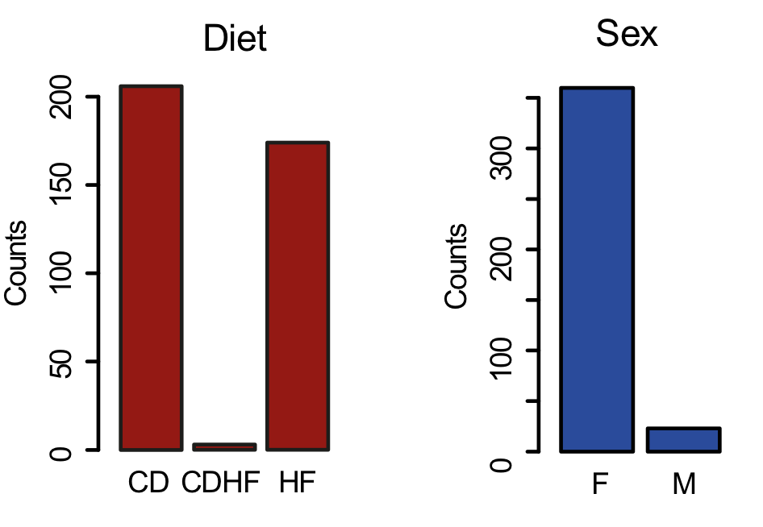
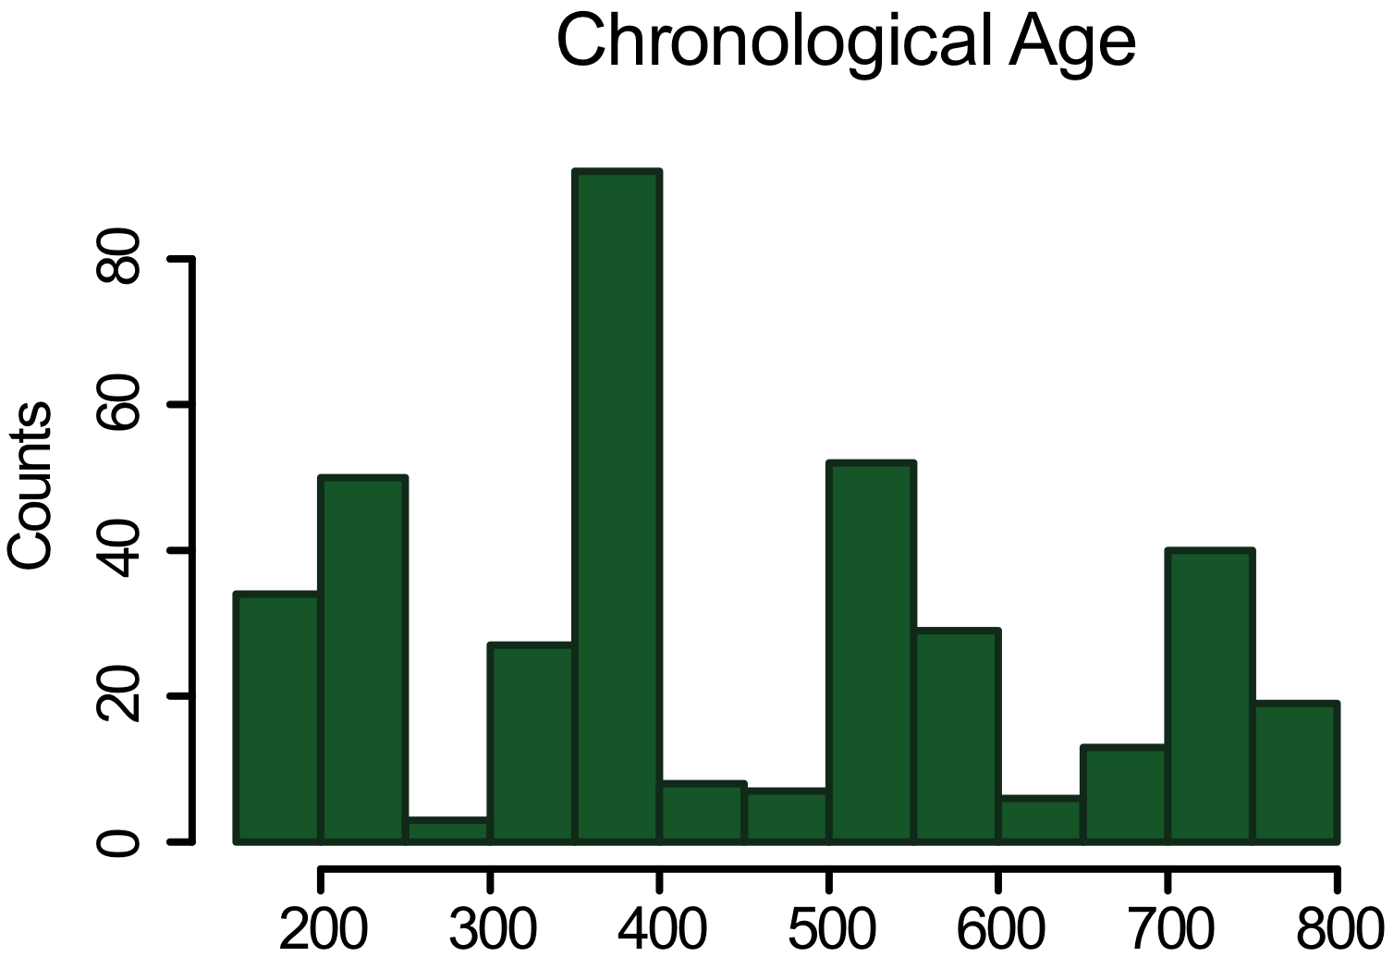
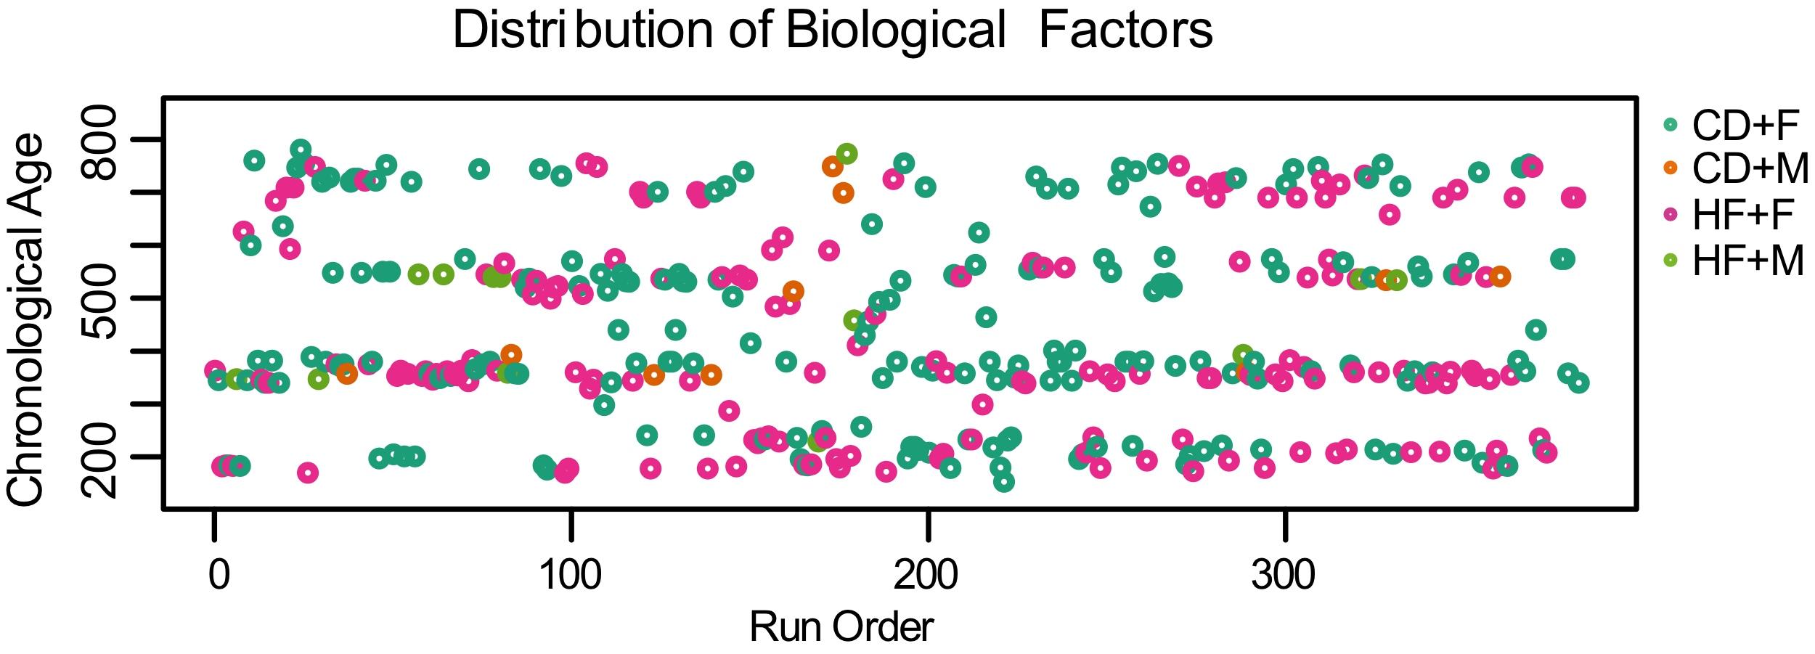
Prevention of batch effects: randomization
Overview of Injected Samples for Proteomics Analysis: 383 samples
Notes:
These samples are of biological factors: different strain, diet, age and sex

Slide 6
Batch effect correction reduces unwanted variance
*
*
*
*
*
*
*
*
*
*
*
*
*
*
*
*

Slide 8
Hierarchical clustering (peptide-level)
After quantile, SVM, ComBat

Slide 9
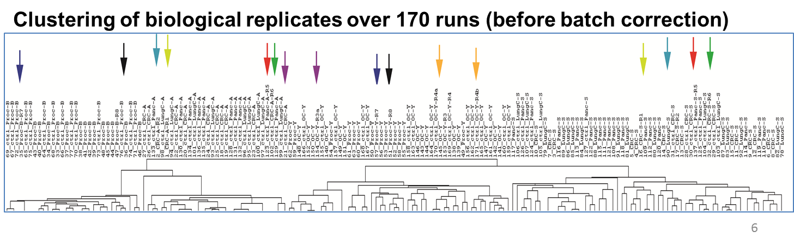
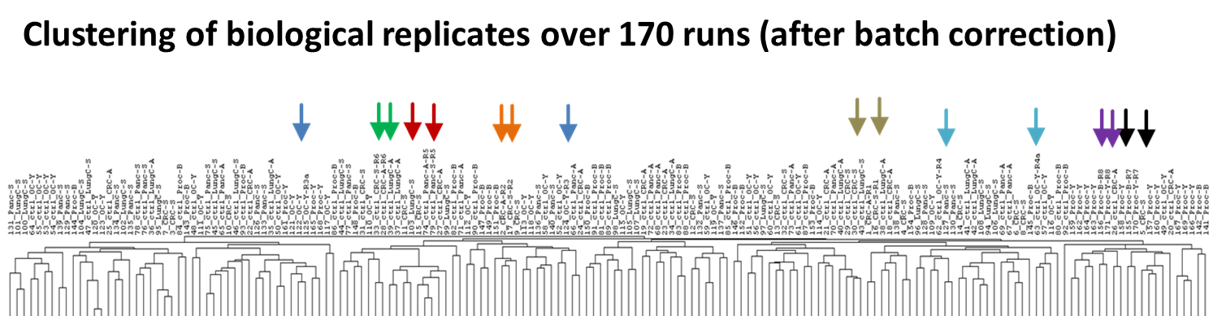
Samples clustering according N-glycoproteins

Slide 11
Correlation distributions

Slide 12
Work in Progress

Slide 13
PVCA before and after

Slide 14
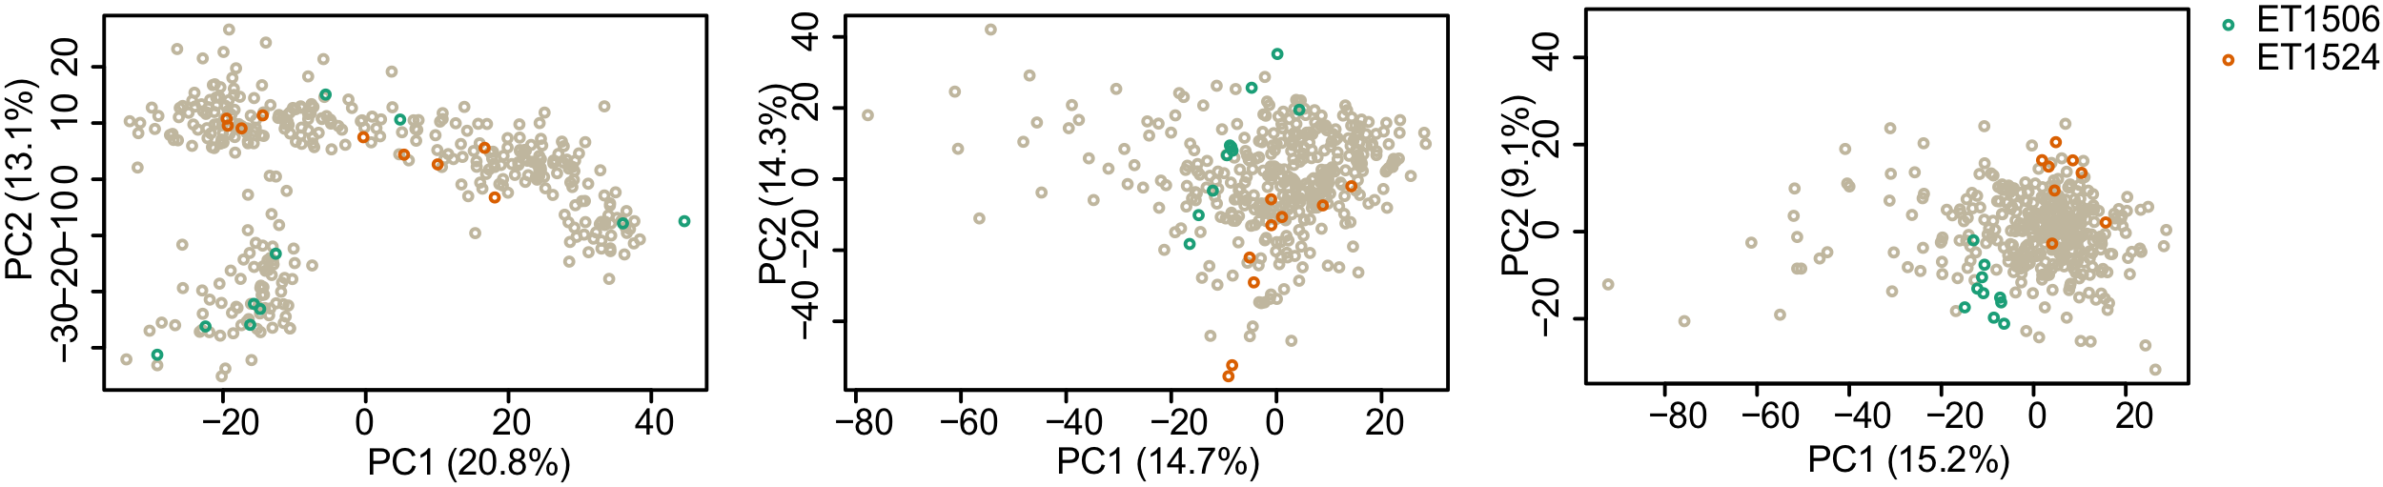
PCA plots: before and after

